Slide 1
Recent Activities of KVN
Do-Young Byun (KASI),
KVN Group(KASI), VERA Group (NAOJ)
2014. Oct. 9
12th EVN Symposium

Slide 2
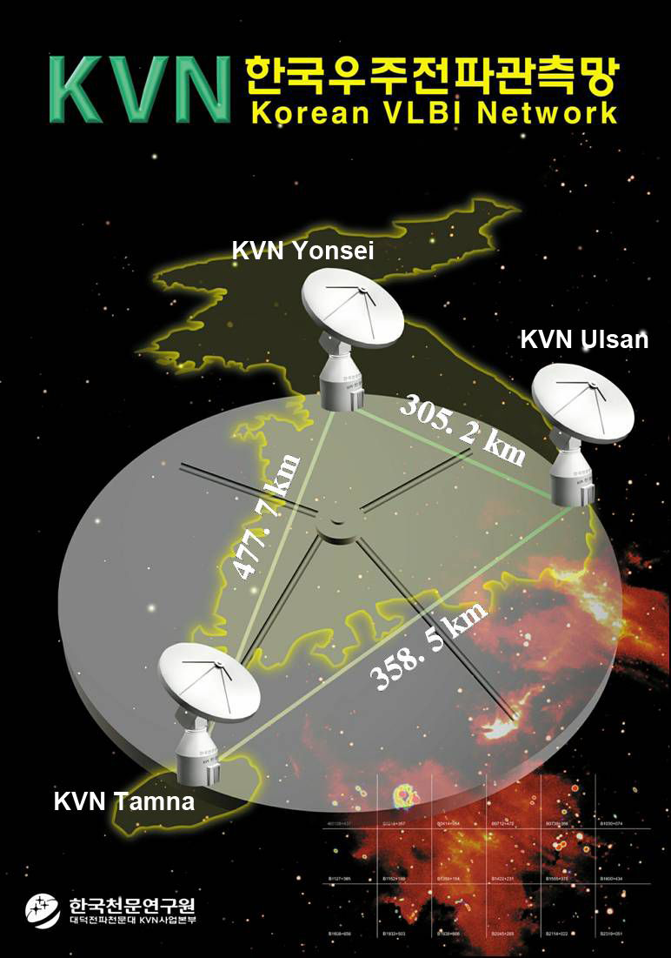
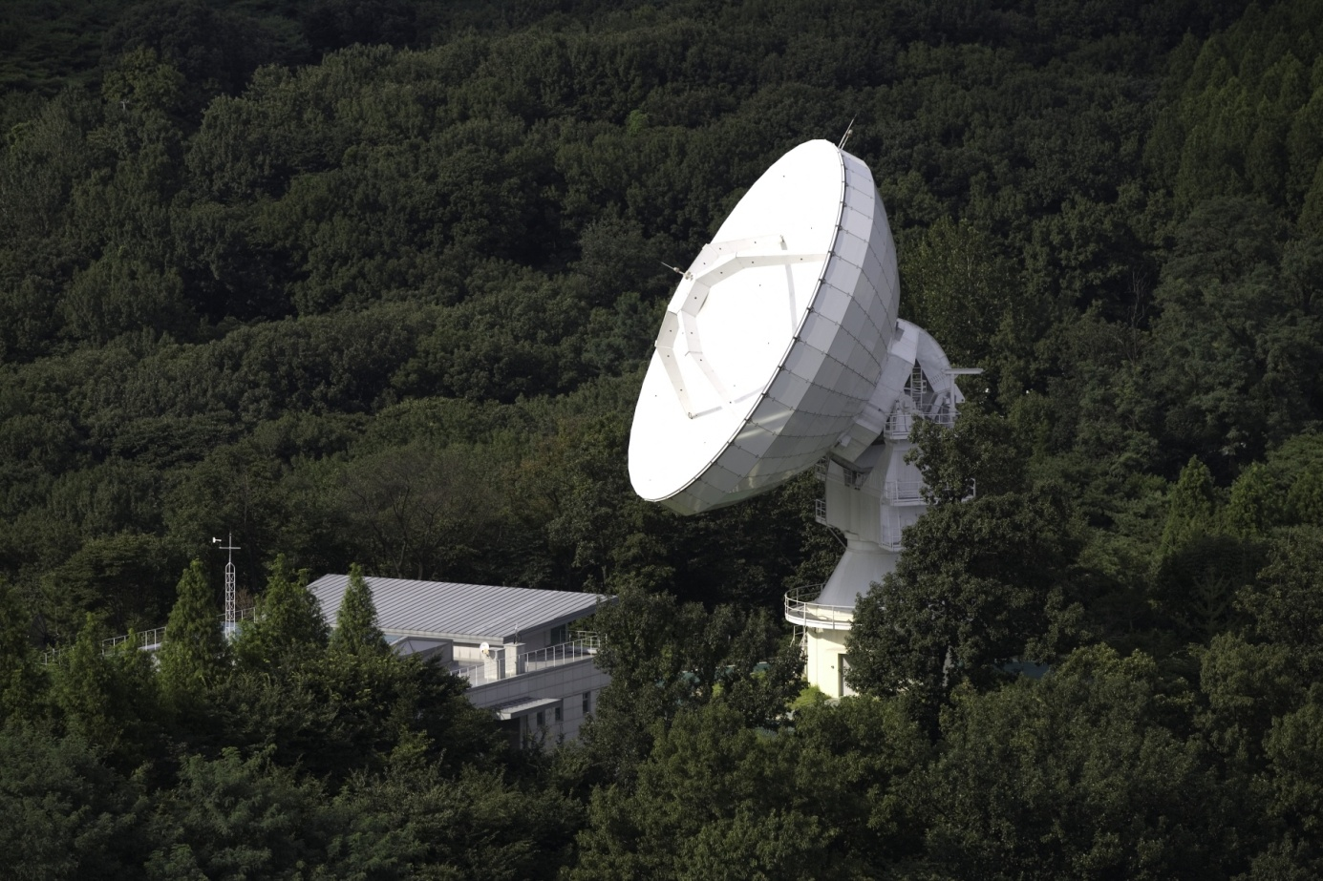
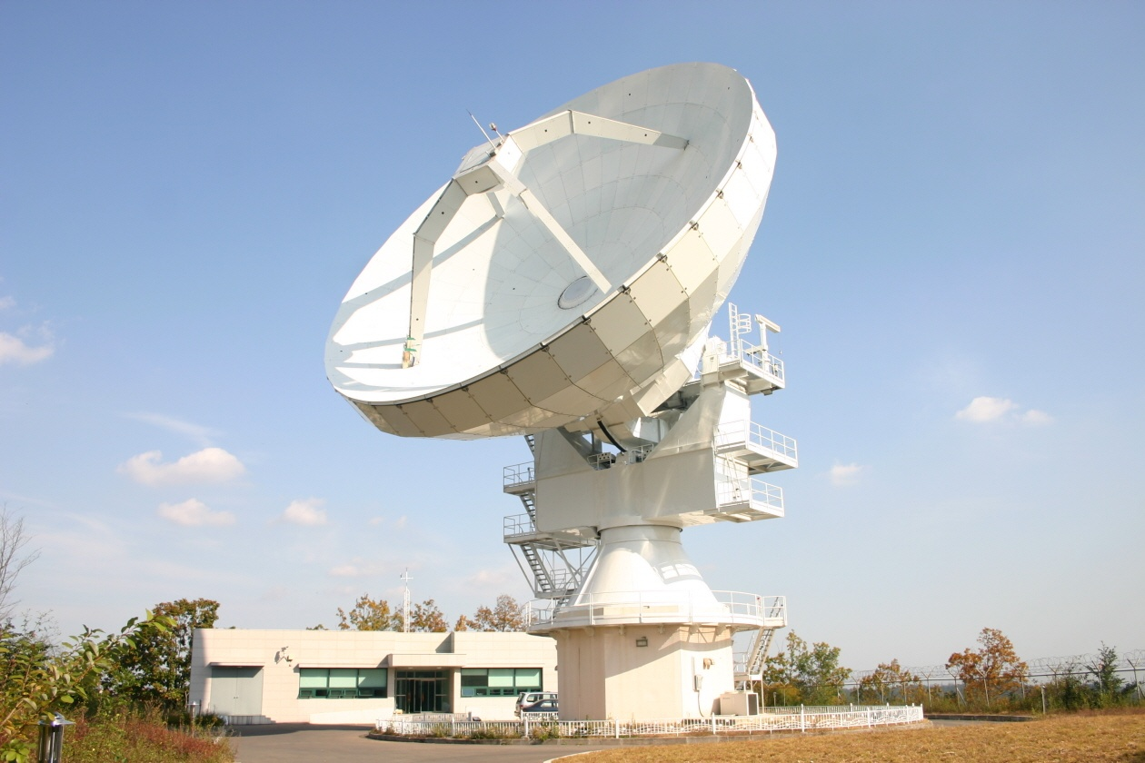
KVN Yonsei
Observatory
Slewing Speed ~3 deg/s
KVN Ulsan
Observatory
θ_{HBPW} ~ 6 mas @ 22
~ 1 mas @ 129
KVN Tamna
Observatory

Slide 3
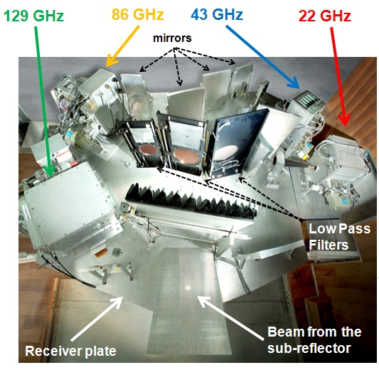
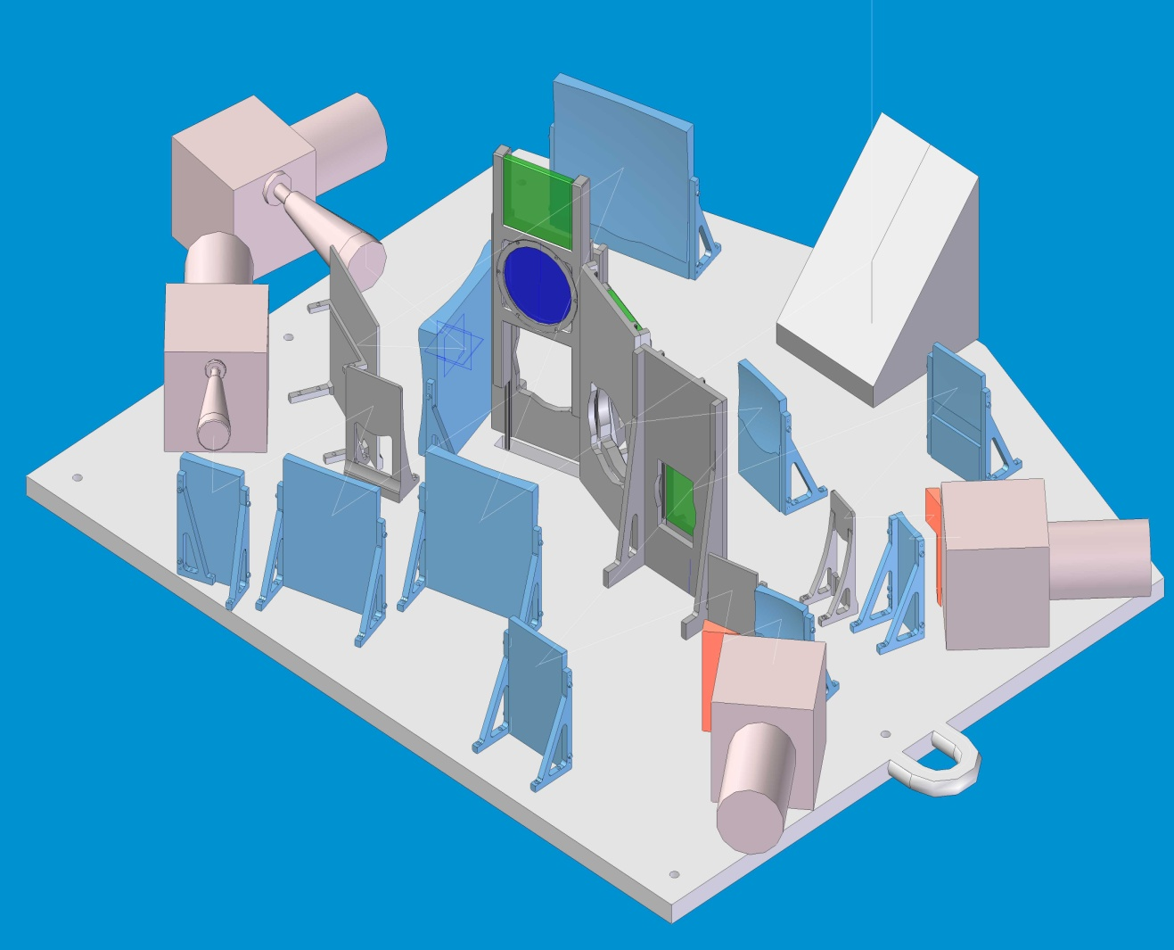
Multi-Frequency Receiving System
Simultaneous Multi-frequency Observation
  @ 22/43/86/129GHz
  Multi-Frequency Observation enable us to overcome limitation of mm-VLBI
    Rapid phase variation due to water vapor in troposphere
    Coherence time scale ~30sec @ 100GHz
  Dual Pol : LCP & RCP ( Simultaneous 2 freq bands of full pol.)
22GHz
43GHz
129GHz
86GHz

Slide 4
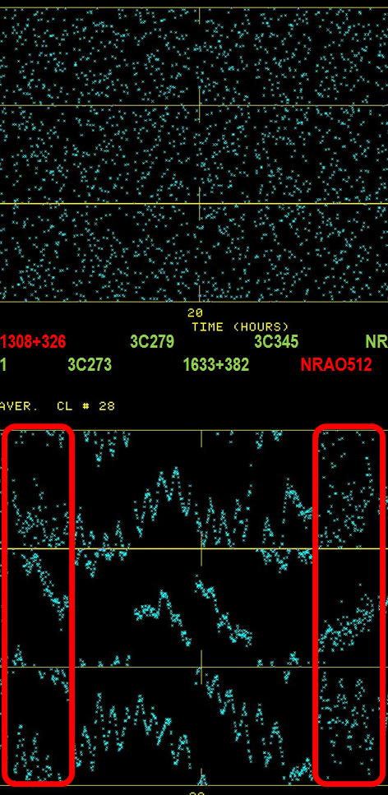

Source : 1308+326
Weak Source Detection
at High Frequency by Multi-Frequency Phase Referencing
(see poster by Taehyun Jung)
Phase Referencing
[before]
[after]
TN - US
Ф_{129, referenced} = Ф_{129,m} – Ф_{22,m} x ( $\frac{ν129}{ν22}$ )
Phase variation due to water vapor ∝ ν
1308+326 : 300~420 mJy at 129GHz
Successful evaluation of MFPR.
Sensitive AGN fringe survey using multi-frequency technique
TN- YS
Visibility Phase @ 129GHz
[-180° ~ 180°]
US - YS
1 hour
1 hour

Slide 5
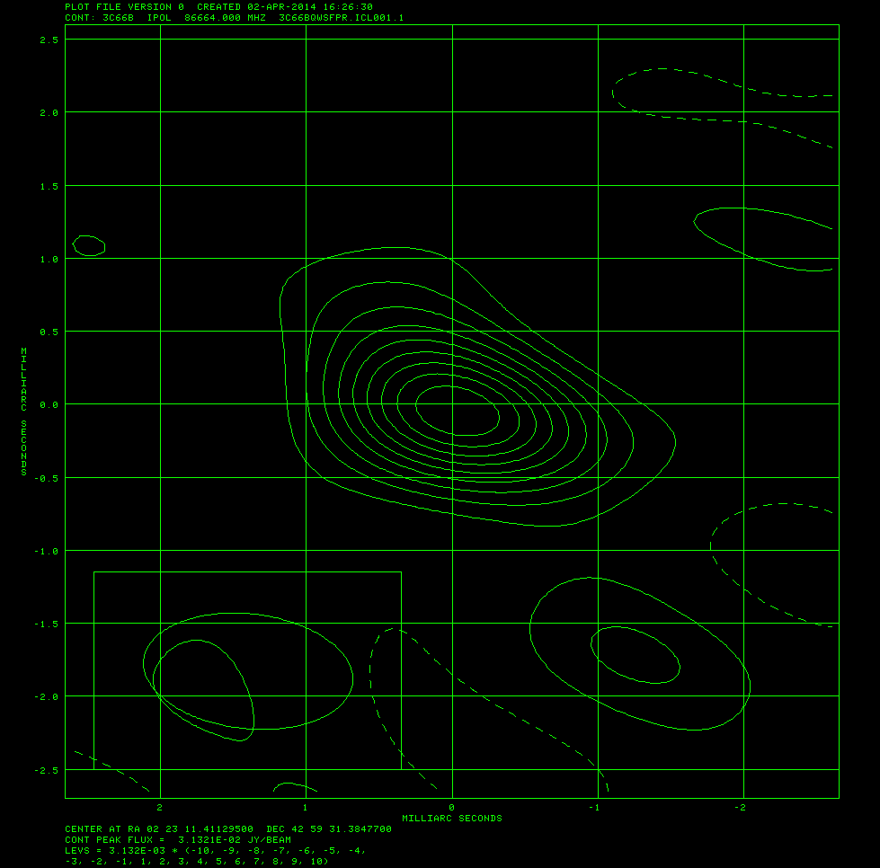
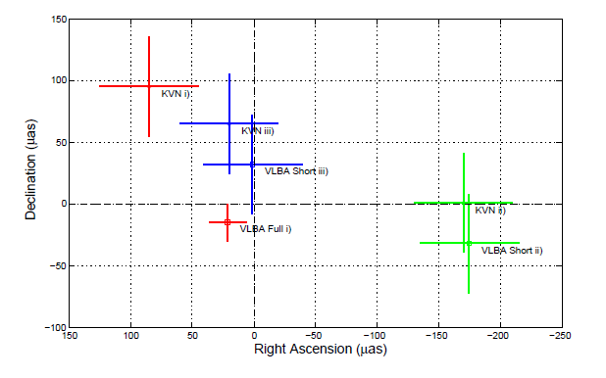
Source Frequency Phase Referencing for AGN core-shift
Maria J. Rioja+, 2014, AJ
KVN Simultaneous 22/43GHz, VLBA Freq Switching
  0854+213 w/ reference OJ287
  1.2deg away
Core shift accuracy ~ 40 μas
Consistent with VLBA within 1σ-error
SFPRed map of 3C66B at 86GHz
(-0.035 mas, -0.048 mas)
Structural blending effect should be considered
Flux recovery ~ 94% using KVN SFPR
* See poster by Zhao for core shift measurement at 22/43/86GHz

Slide 6
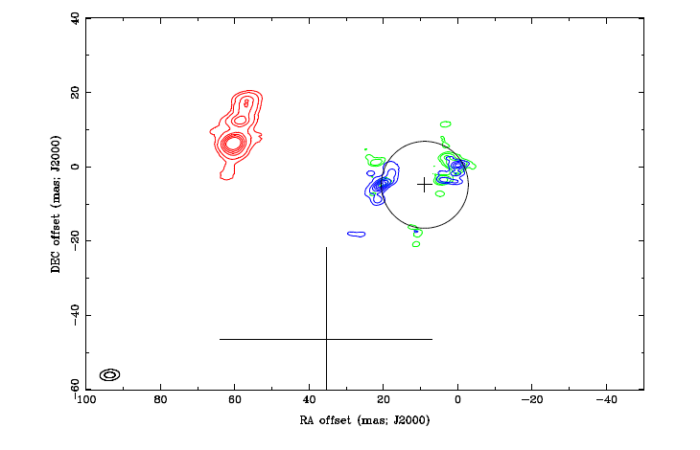
Source Frequency Phase Referencing for Stellar Maser Lines
Richard Dodson+, 2014, AJ accepted
H₂O at 22GHz and SiO (v=1,v=2) at 43GHz of R LMi
  Reference : 4C39.25 ~ 6 deg away
H₂O position accuracy< 3x5 mas
mas-level astrometric alignment of SiO maser wrt H₂O maser
Water Maser
SiO Masers
Position from Hipparcus

Slide 7
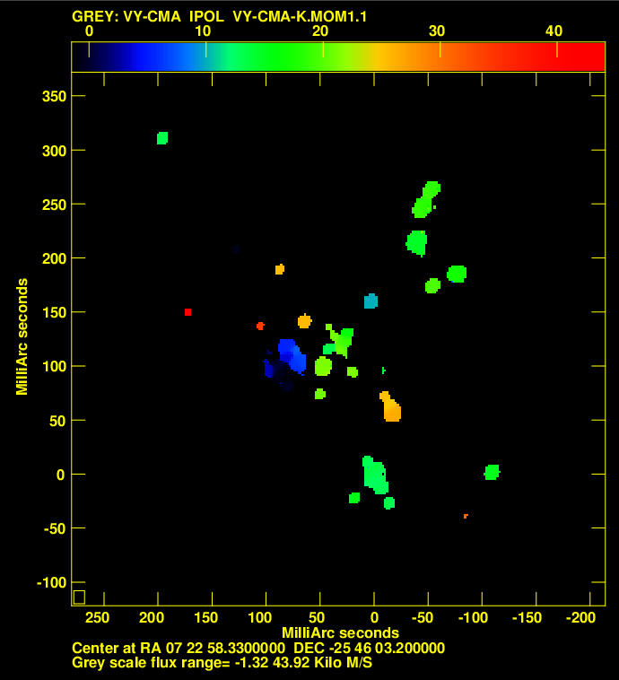
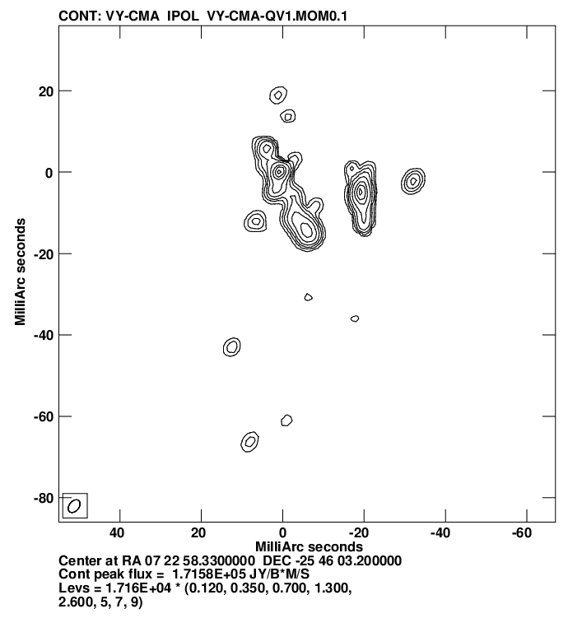
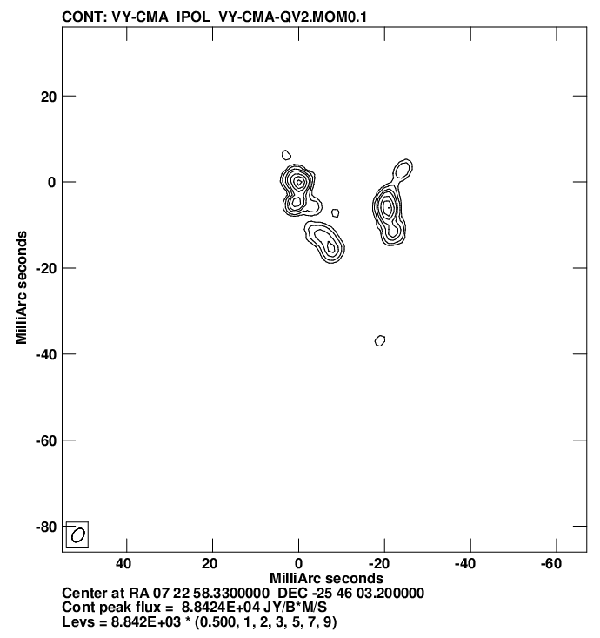
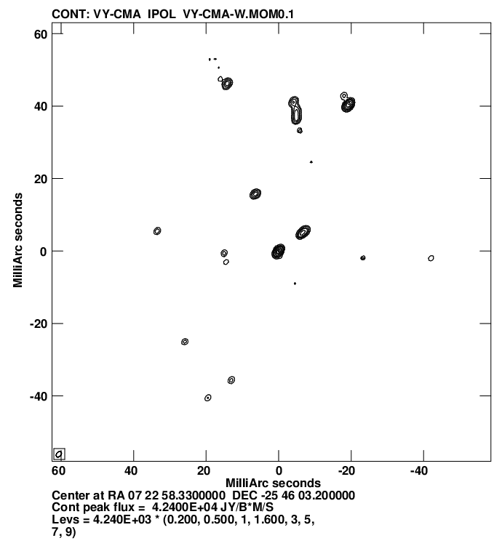
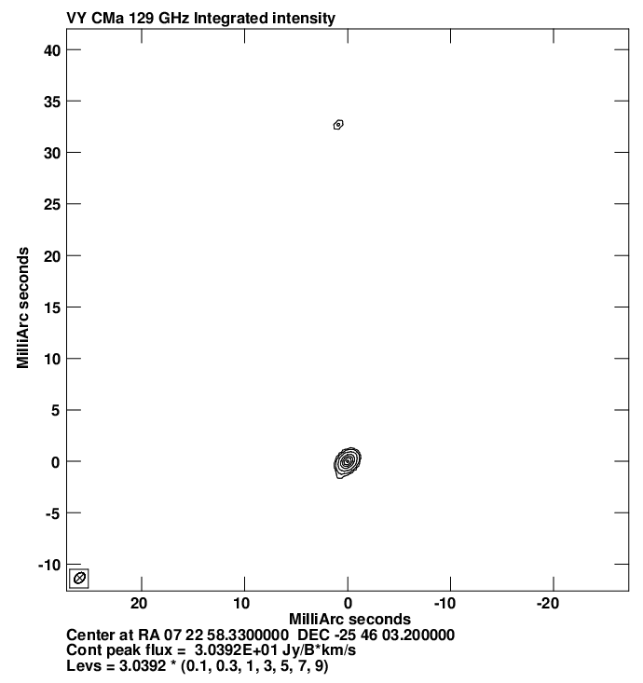
Multi-Frequency Snapshot Imaging of Evolved Star VY CMa (22/43/86/129 GHz Bands, 2013 April, by Cho +)
Supergiant VY CMa, H2O(22GHz)
SiO v=1, J=1-0 (43GHz)
SiO v=2, J=1-0 (42GHz)
SiO v=1, J=2-1(86GHz)
SiO v=1, J=3-1(129GHz)
Multi-freq multi-epoch observations
To derive fundamental parameters of the maser such as dynamical timescale, mass loss rate etc.
To trace change of physical parameters in SiO and H₂O maser regions.
Asymmetric wind or jet like structure

Slide 8
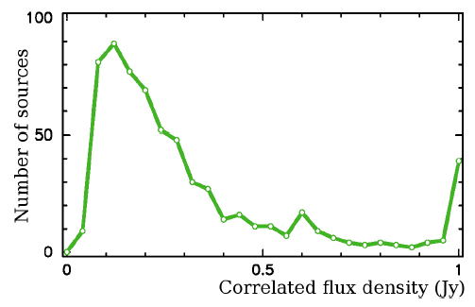
KVN AGN Surveys
Q-Cal
Previous
22GHz Calibrator Survey (Lee J.A+ in prep)
43GHz Fringe Survey (Petrov+ 2012)
fringe detection from 637 sources among 799 (78%)
43GHz detection threshold: ~100mJy (5σ)
43GHz
86GHz Fringe Survey (preliminary, Petrov & Lee in prep)
- fringe detected from 390 sources among 548 targets (~71%)
- 354 sources are new detection (SNR > 6)
129GHz Fringe Survey ( under data analysis by Lee +)
More Sensitive Survey using Multi-Frequency Phase Transfer

Slide 9
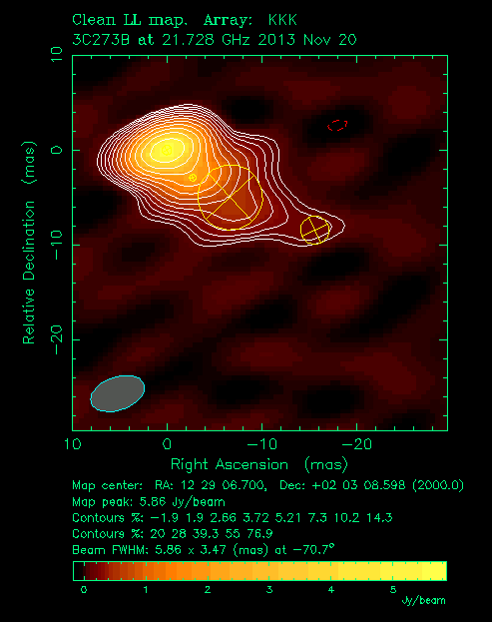
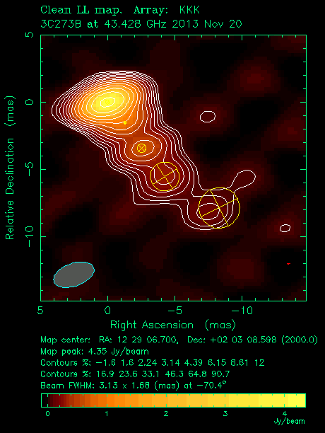
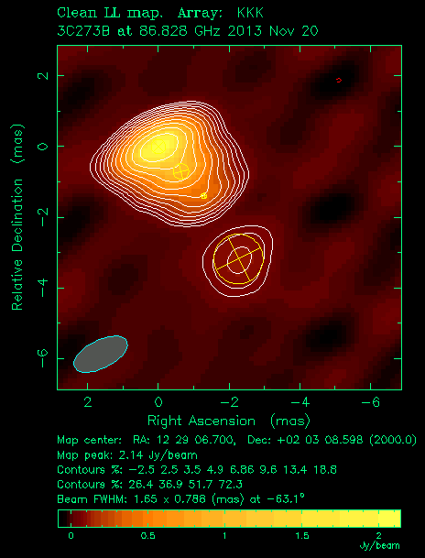
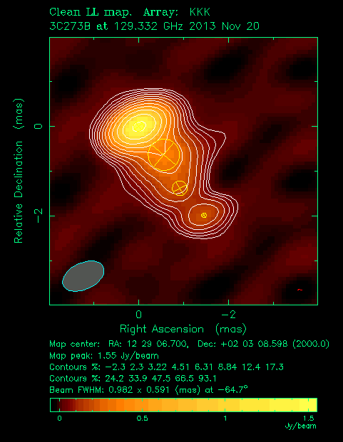
Monitoring of Gamma-ray Bright AGN
22G
43G
40 mas
20 mas
by Sang-Sung Lee+
- > 30 Sources
Multi-Frequency Snap Shot Imaging
22/43/86/129GHz
1 month interval
+ Single-Dish Polarization
86G
129G
10 mas
6 mas

Slide 10
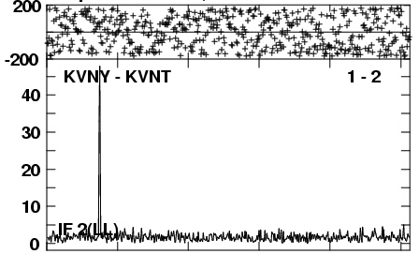
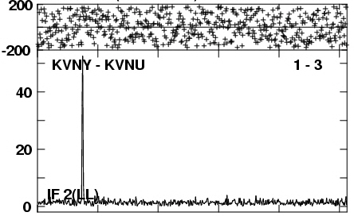
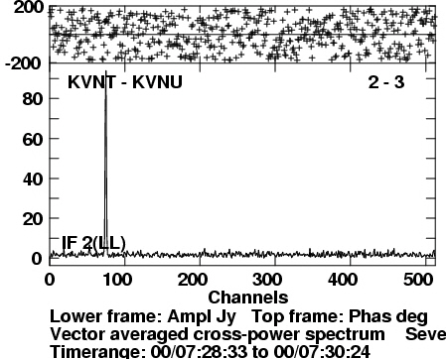
44GHz CH3OH Fringe Survey toward massive SFR
37 44GHz Class I CH₃OH maser sources (Kim+ in prep) - KVN SD surveys (25, >50 Jy) - VLA obs: Kogan & Slysh 98 (4, >50 Jy ), Kurtz+ 04 (8, >10 Jy)
-> FRINGEs detected in 11 sources , 3 of them show detected fringes on all three KVN baselines
G10.32-0.26(6.0 kpc), G18.34+1.74 SW (2.7 kpc), G49.49-0.39 (6.0 kpc)
First VLBI detections of Class I CH₃OH masers !
-> more compact structures than previously thought: <50 AU the three : structures of <20 AU
G10.32-0.26
Notes:
- Accretion model:
More turbulent → can make more dense cores → shorter f-f time scale → higher accretion rate
Stellar mass upper limit because of Radiation pressure: 20-40 M_sol
Stellar mass upper limit using disk: about 40 M_sol

Slide 11
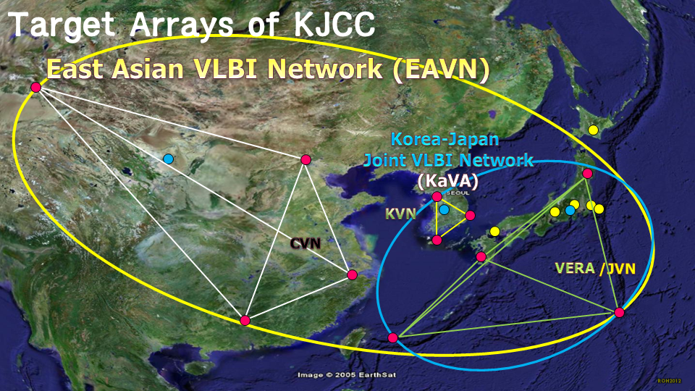
KaVA
(KVN and VERA Array)
VERA
KaVA
KVN and VERA are complimentary each other
  - short baseline of KVN
  lone baseline of VERA
  KaVA can detect extended structures
~1000h for KaVA in 2014

Slide 12
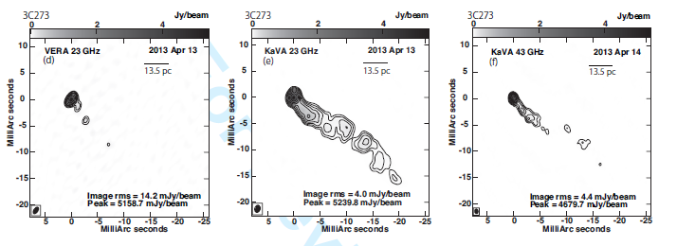
KaVA Imaging of AGNs
Imaging performance evaluation (Niinuma+, 2014, PASJ)
  Images of 3C 273 at a recording rate of 128Mbps (BW:32MHz)
  VERA 22GHz KaVA 22GHz KaVA 43GHz
KaVA 1Gbps image of M87
DR ~ 1360
* See poster by Kino

Slide 13
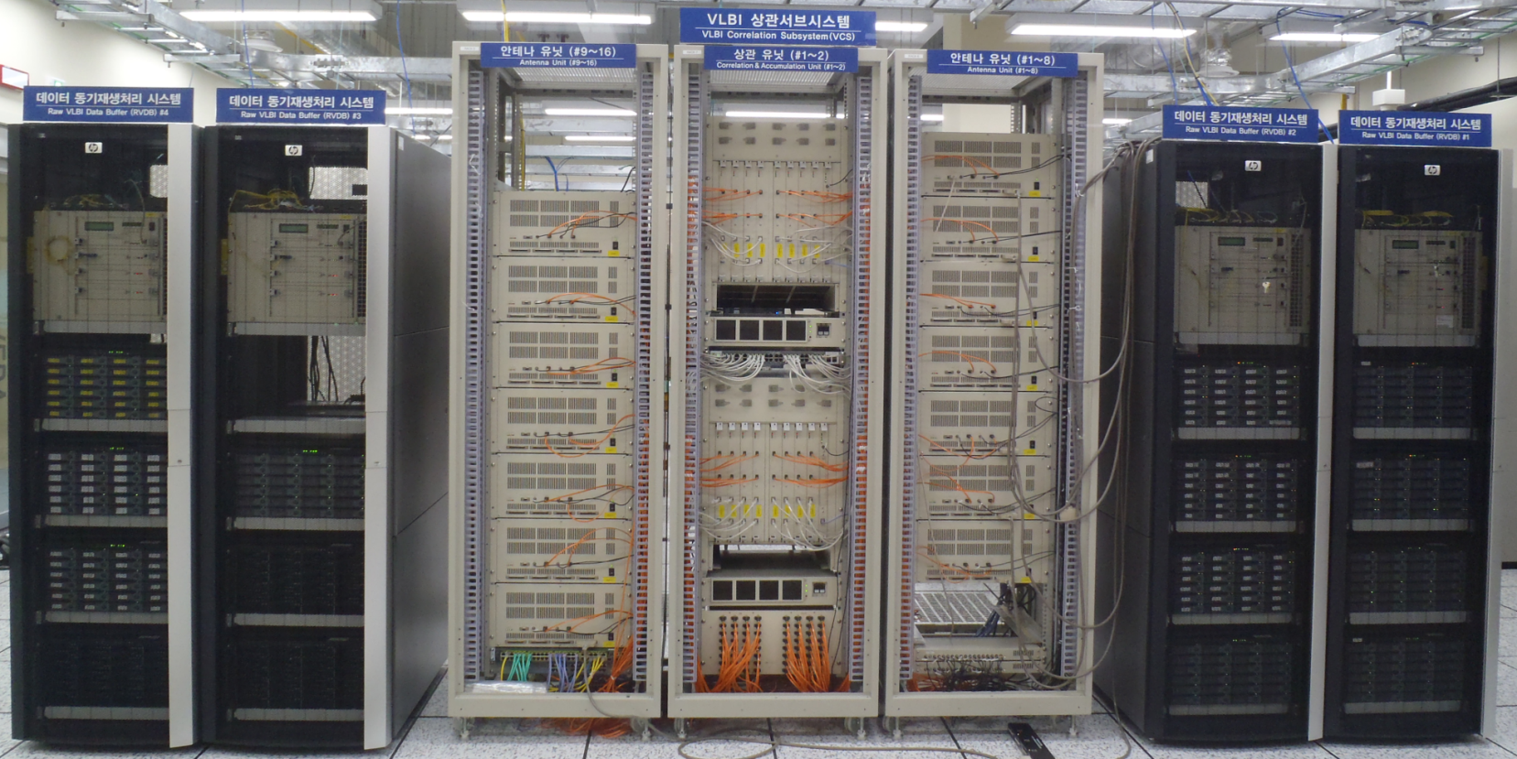
Daejeon Correlator at
Korea-Japan Correlation Center (KJCC)
Joint Development & Joint Operation by KASI & NAOJ
Input Data Rate = 4 streams x 2Gbps x 16 stations

Slide 14
Complimentary
  KVN has Short baseline
  VERA has Long baseline
Fringe Test of EAVN at 8GHz and 22GHz from Sep 2013
Correlation by Daejeon Correlator

Slide 15
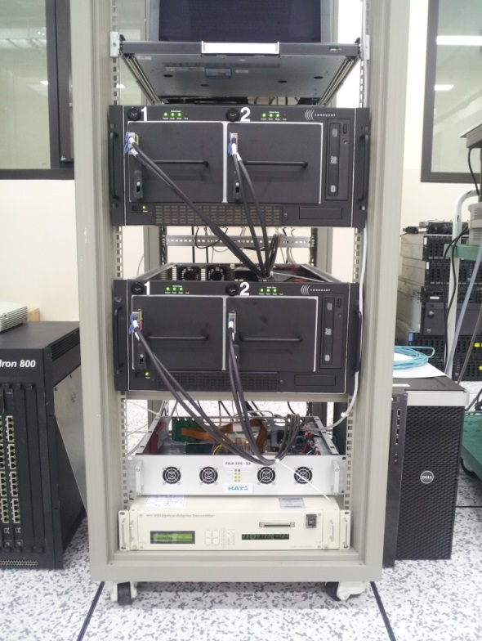
System Upgrade Activities
Multi-Frequency P-Cal
  22 – 130 GHz w/ 200MHz Step
8Gbps operation
  Digital Output : 2Gbps x 4 streams
  (Mark5B : 1Gbps recording)
  Mark6 (16Gbps max)
  + Fila10G
  Fringe Test soon
Network Speed Upgrade
  10Gbps to Yonsei
  5Gbps to Ulsan, Tamna

Slide 16
Common Use
KVN Common Use
  2013B semester : Open to Korean community
  2014A & B: Open to East Asian community
  2015A semester : Open to East Asian community
    Deadline: Nov. 6th
    Open Use Time : ~300h
    22, 43, 86GHz : normal , 129GHz : risk shared
  2015B semester : plan to open to World community
KaVA Common Use
  2014A & B : Open to Korean & Japanese community
  2015A semester : Open to East Asian community
    Deadline: Nov. 6th
    Open Use Time : ~ 250h
    single frequency observations at 22GHz or 43GHz
    Risk shared basis, Imaging only

Slide 17
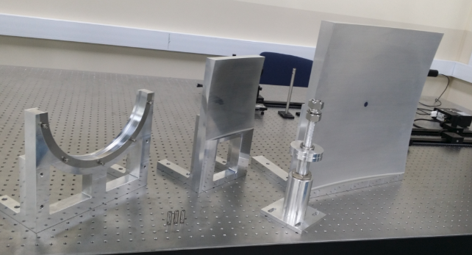
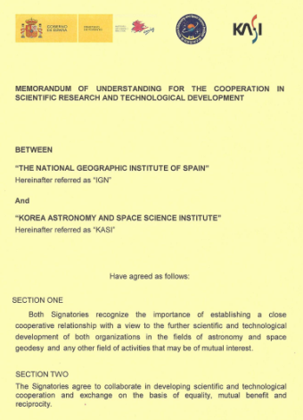
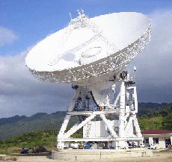
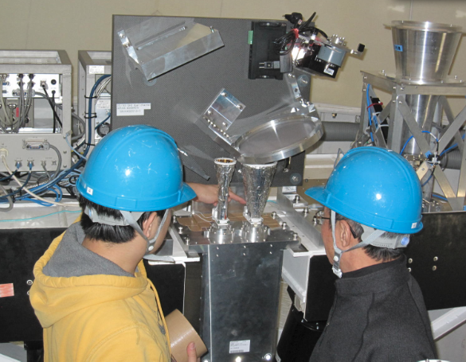
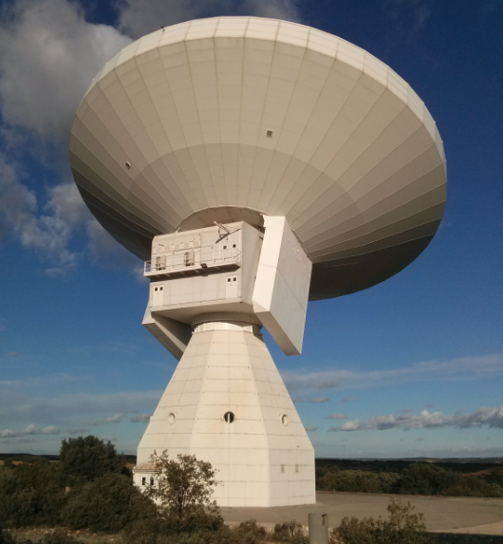
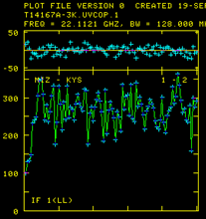
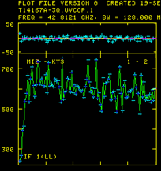
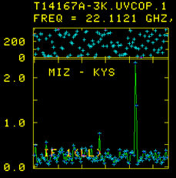
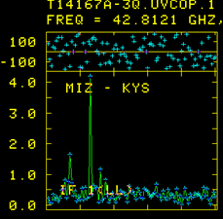
Quasi-Optics as a Powerful Tool of mm-VLBI
Collaboration with Yebes 40m & VERA Mizusawa
History & Plans
▫ 2011 Nov. : K/Q/W QO discussion
▫ 2014 Jan-Aug : QO design
▫ 2014 Jun : KASI-IGN MOU
▫ 2014 Sep : Manufacture
▫ 2014 Oct : Shipping to Yebes
▫ 2014 Nov : Installation & Initial Test
▫ 2015 Jan : K/Q band fringe test
History & Plans
▫ 2013 Nov : Manufacture
▫ 2013 Dec. : Shipping & Installation
▫ 2014 Jun : K/Q VLBI fringe test
▫ 2014 Dec : Science verification test
K/Q simultaneous fringes of OJ287
H₂0/SiO Simultaneous fringes of ORION-KL
Success
on
QO test outside of KVN
H₂O
SiO
22GHz
43GHz

Slide 18
Summary
KVN is in steady operation (> 3000h / yr)
  Open to East Asian community from 2014
  Plan to open to world community in 2015B.
KVN is producing early science results
  SFPR capability were demonstrated successfully
  Weak source detection using MF capability
Daejeon Correlator is in operation for 1Gbps data of KaVA & EAVN
KVN and VERA cooperate conducting sciences
  First VLBI images of Class I methanol masers
  High dynamic VLBI images of AGNs
KaVA open use for East Asian community
  Open to world community in near future

